Slide 1
First 5
Simplify the ratio 27:18:12 =
4% of $1,000,000 =
200 mm² = _________ cm²
A shoebox has dimensions 30cm x 15cm x 20cm, what is its volume ?
0.01 kg = _________ g

Slide 2
First 5
Simplify the ratio 27:18:12 = 9:6:4
4% of $1,000,000 = $40,000
200 mm² = ___2 cm²
A shoebox has dimensions 30cm x 15cm x 20cm, what is its volume ? 9000 cm³
0.01 kg = _____10 g

Slide 3
Topic: metric units of mass EQ: what’s in our food?
Year 11 Essentials

Slide 4
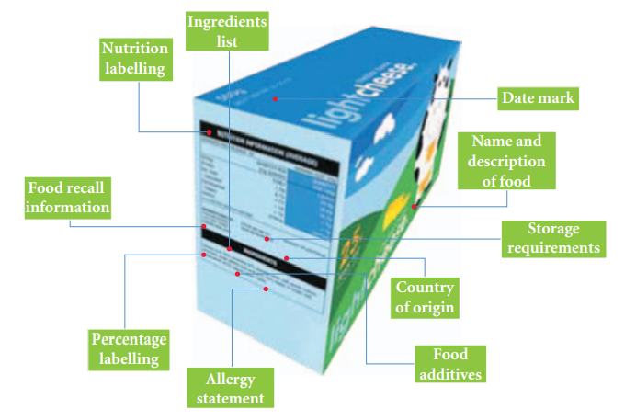
24
7
30
Topic: Metric Units of Mass
EQ: What’s in our food?
What information is on a food label?
Australian law requires all food labels to give the following information:

Slide 5
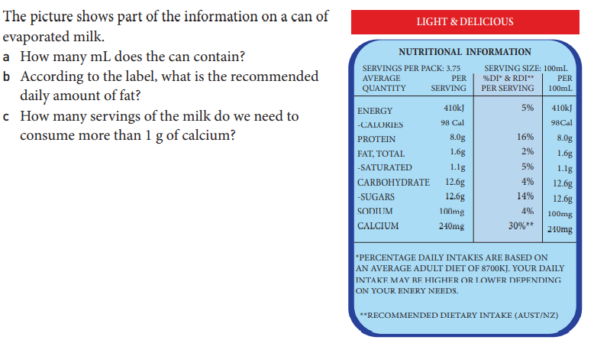
24
7
30
Topic: Metric Units of Mass
EQ: What’s in our food?
What information is on a food label?
Example: on a can of evaporated milk
Amount in the can = 3.75 x 100
= 375 mL
2% of the daily amount of fat = 1.6 g
Multiply by 50 to get
100% of the daily amount of fat = 80 g
Each serving contains 240 mg of calcium
There are 1000 mg in 1 g
1000 ÷ 240 = 4.17 servings

Slide 6
Do: Nutritional Information Worksheet

Slide 7
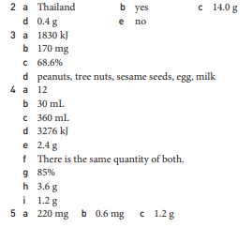
Answers to Nutritional Information Worksheet

Slide 8

Thank you
Keep up the good work!

